Slide 1
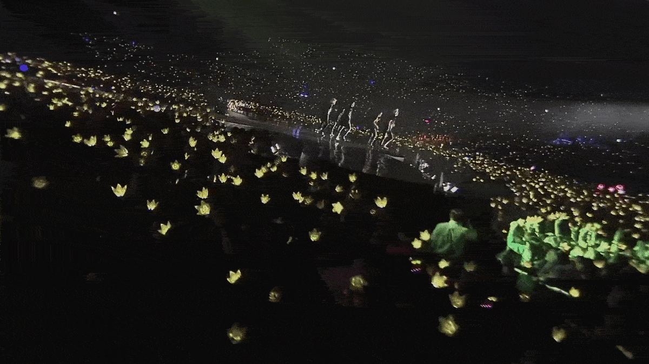



Slide 2
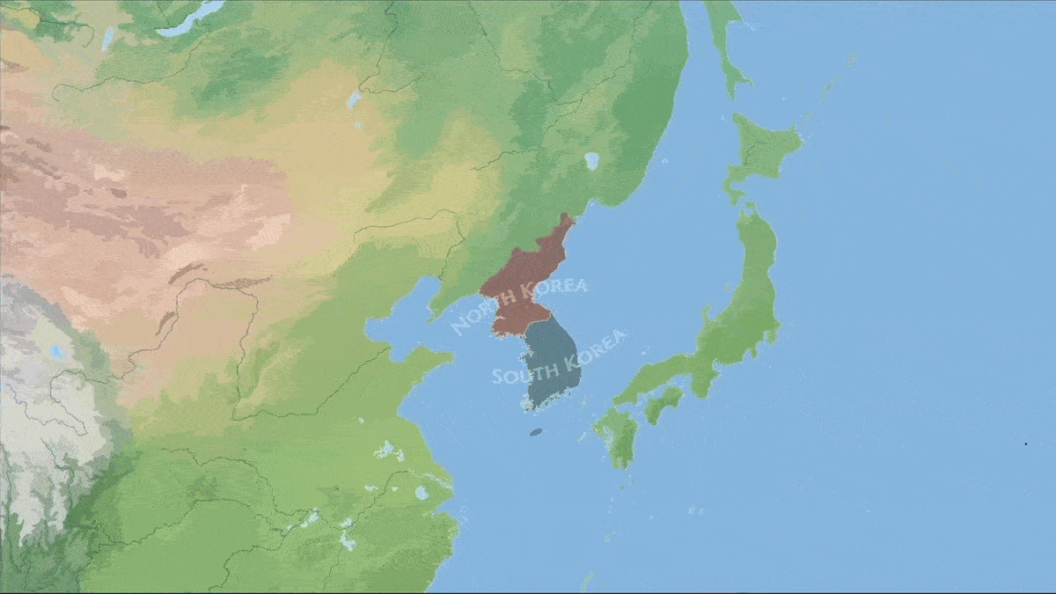
K-Theatre
What's Fostering Downstage in the Korean Peninsula

Slide 3
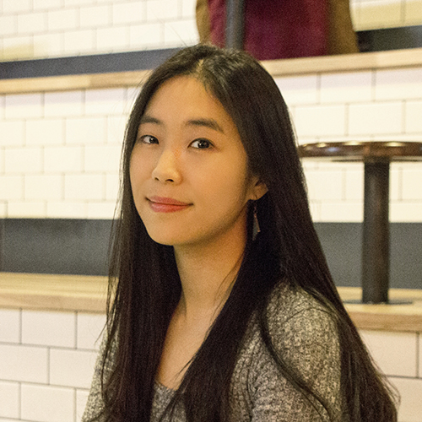
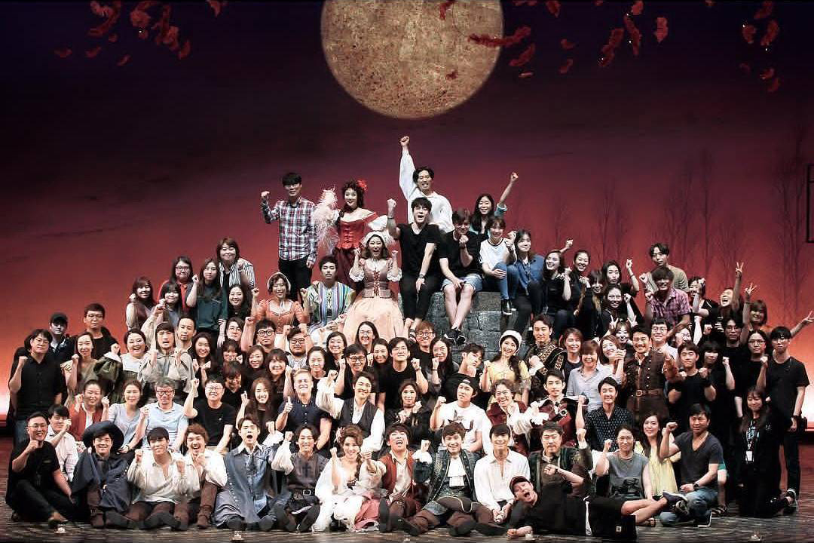
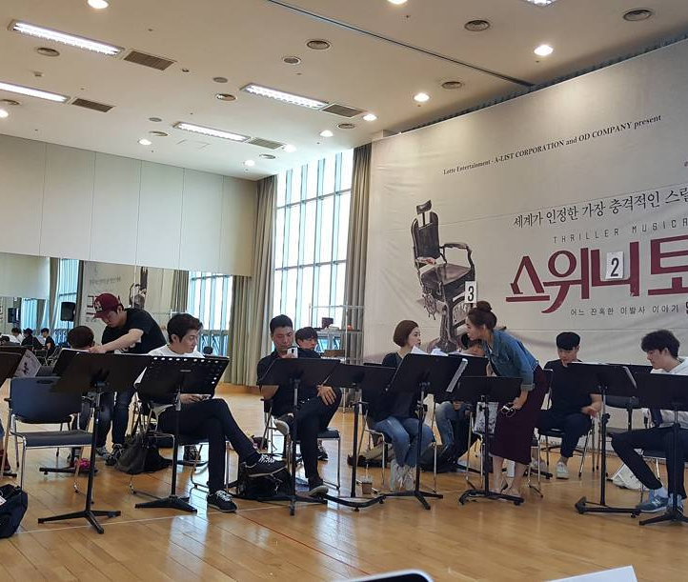
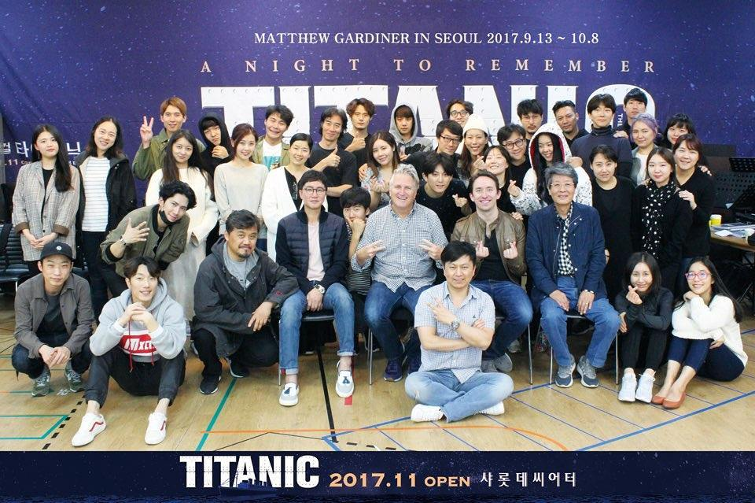
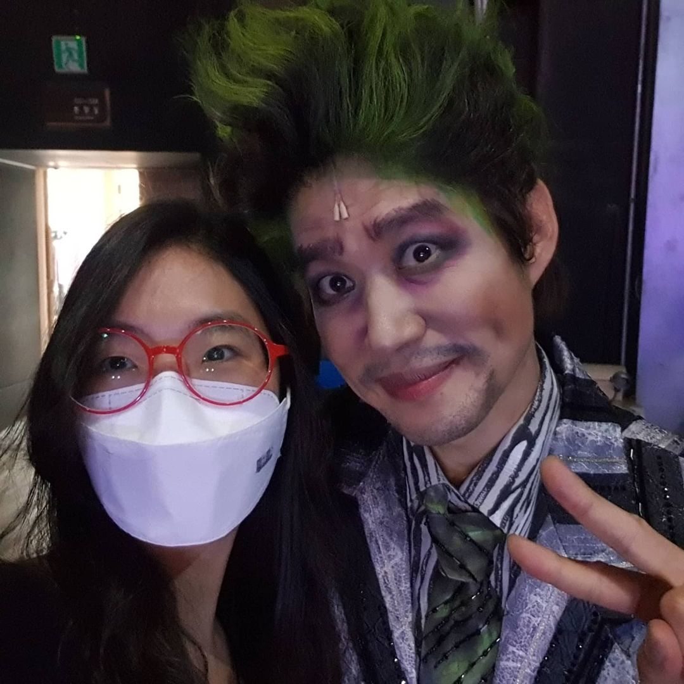
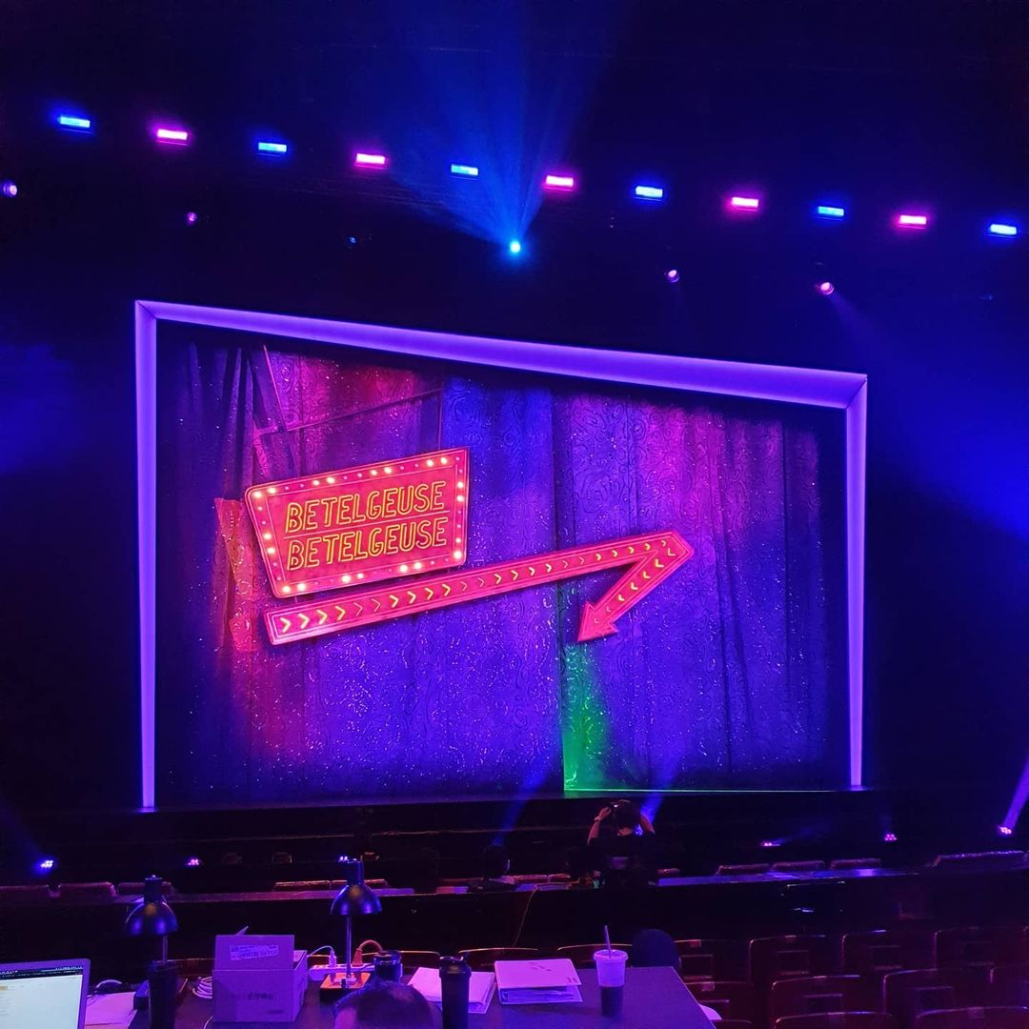
Soovinique Kim
Production Localizer and Translator

Slide 4
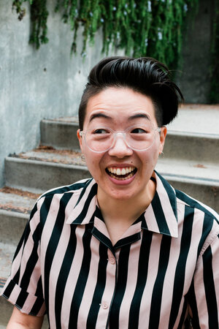
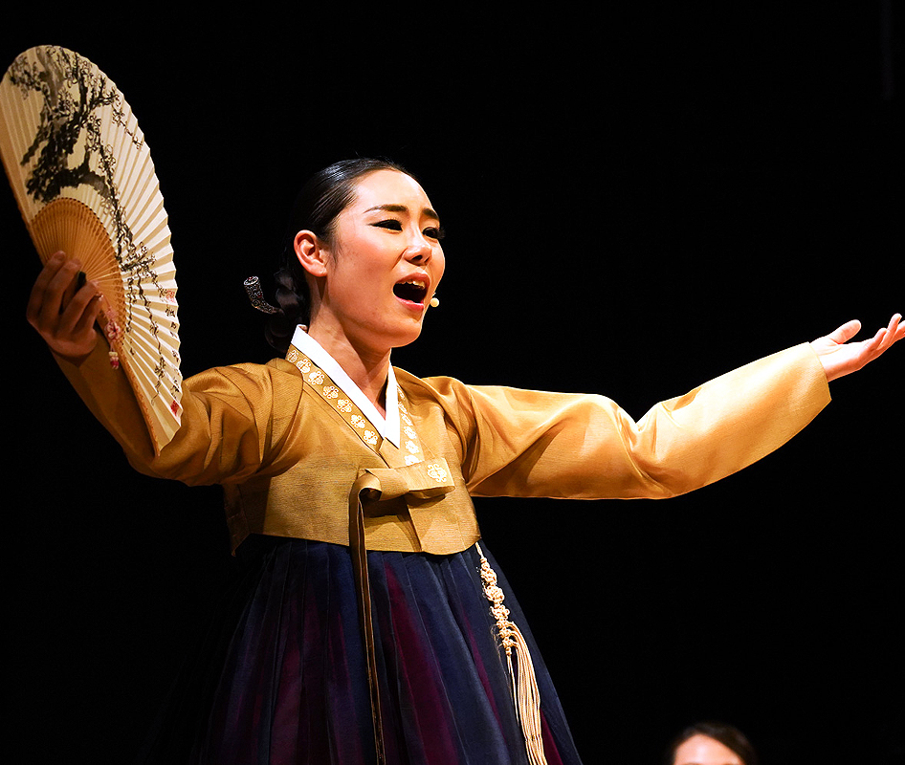
Jihye Kim
Dramaturg

Slide 5
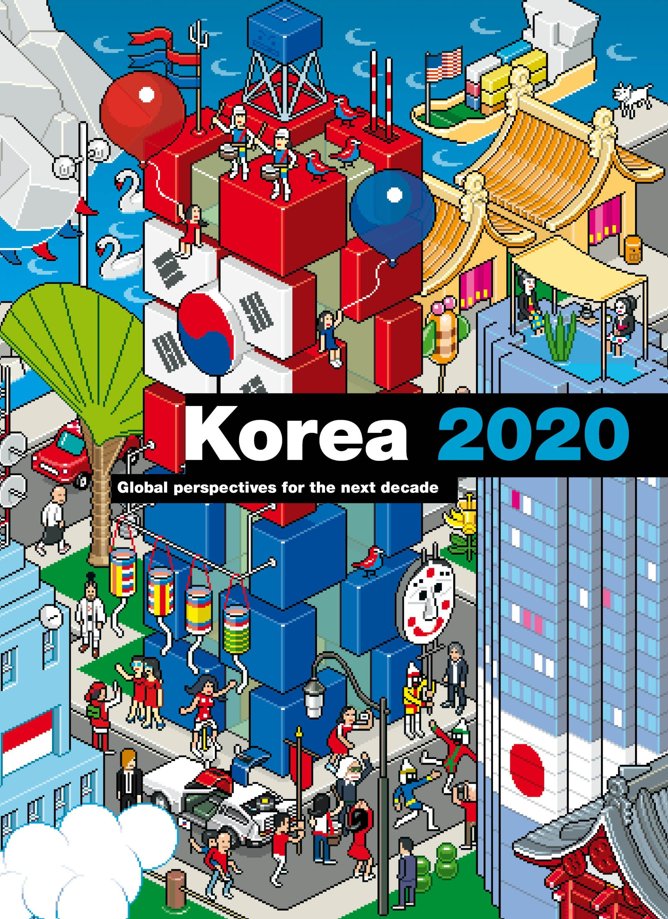
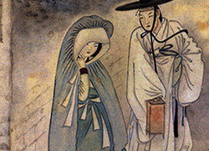
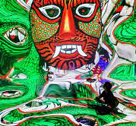
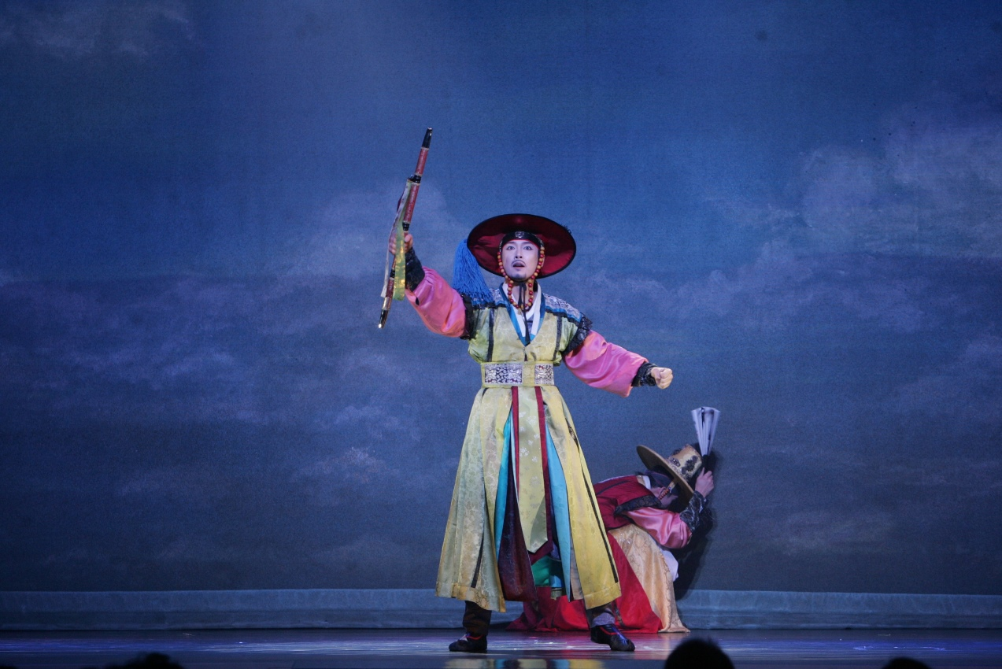

Slide 6
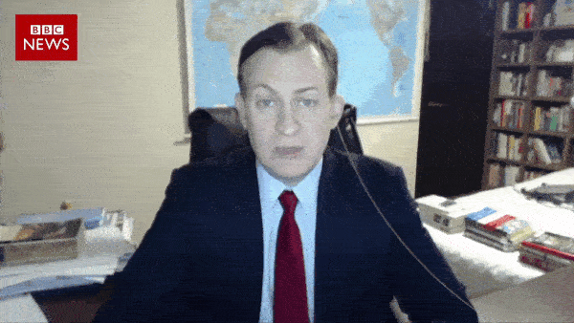

Slide 7
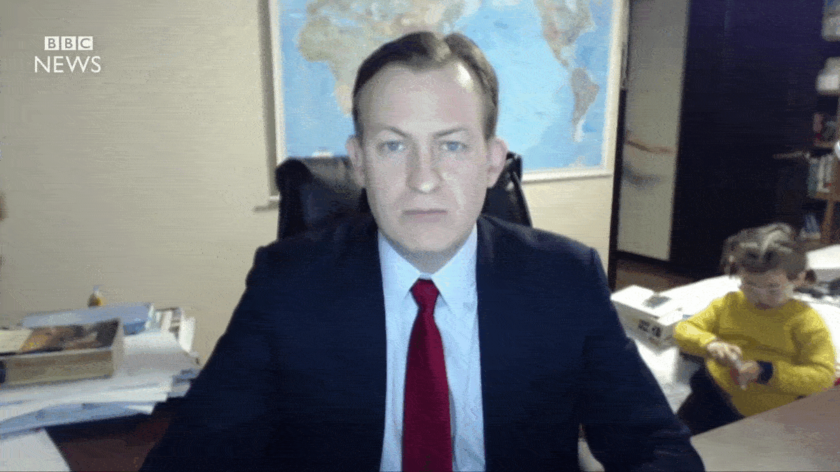

Slide 8
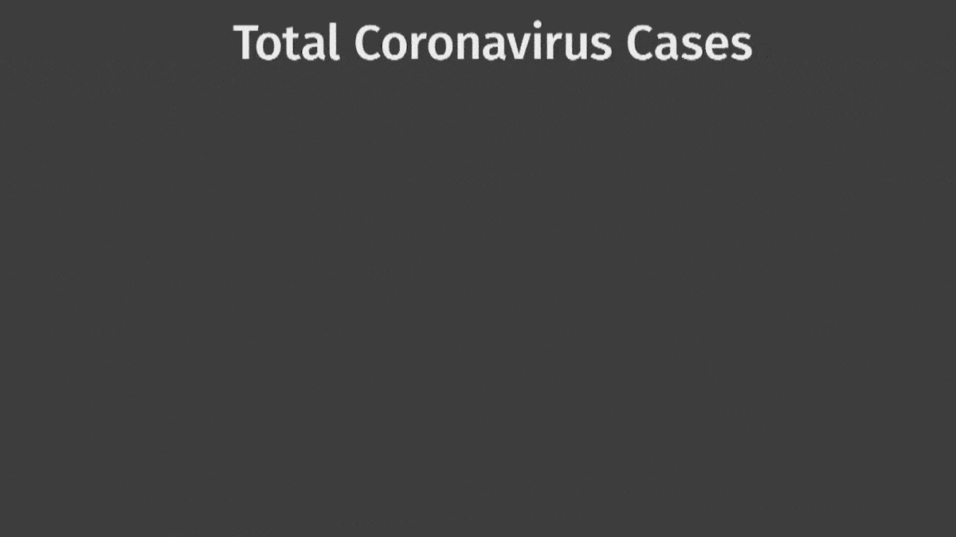


Slide 9
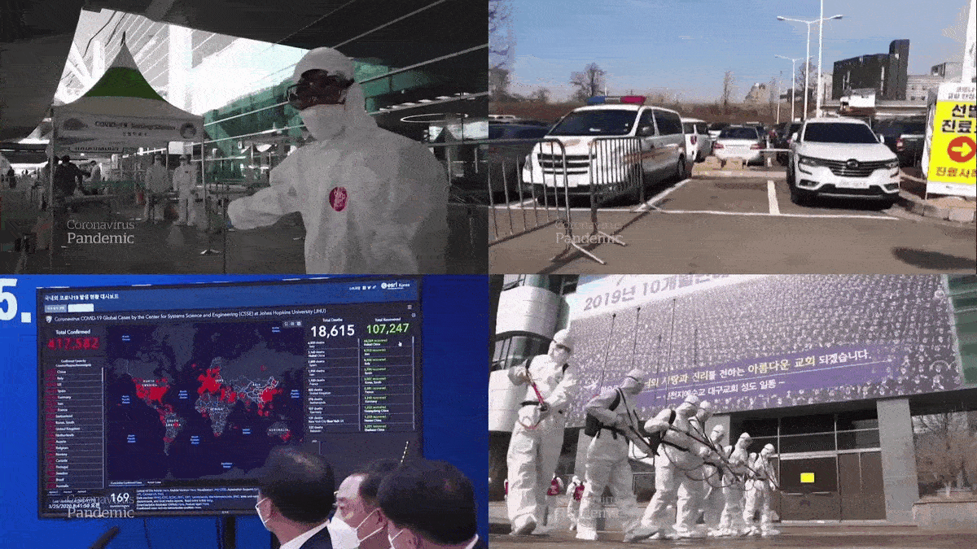

Slide 10

₩330,000,000,000
The Show Must Go On

Slide 11
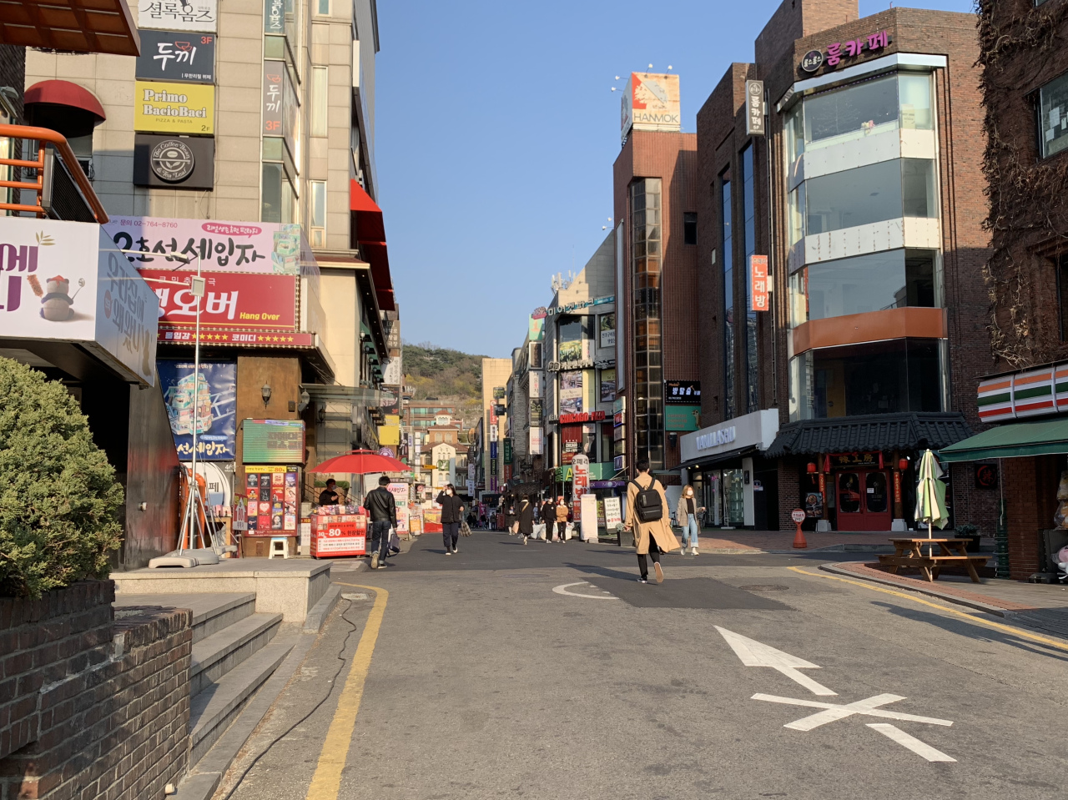
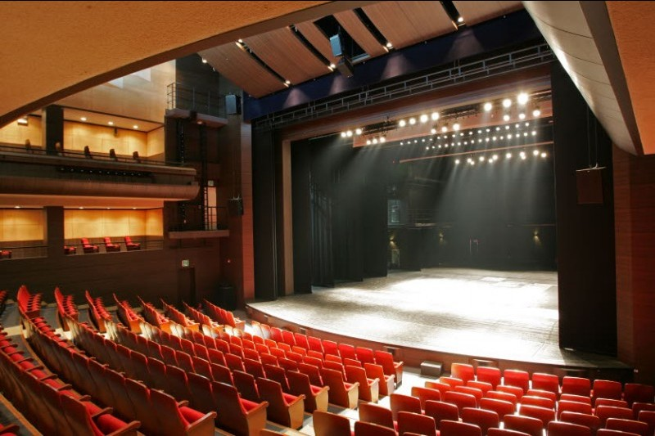
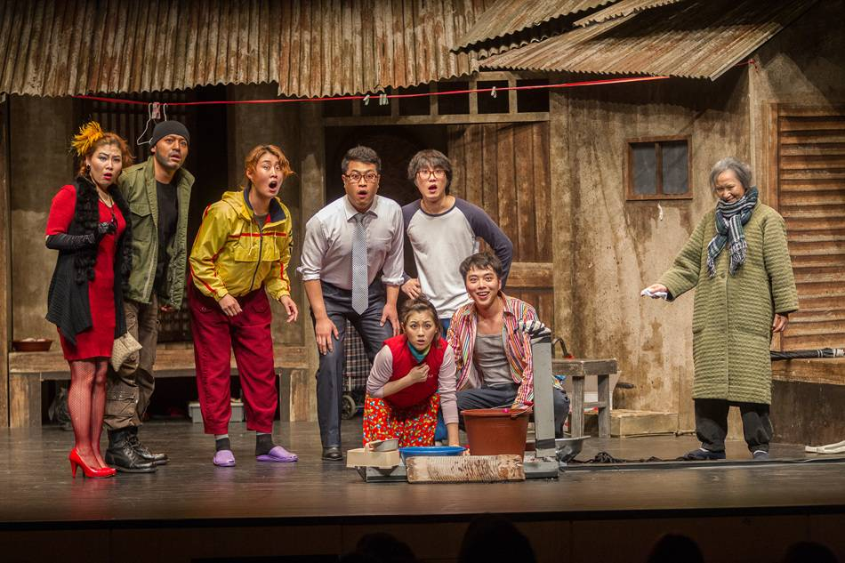
Daehangno

Slide 12
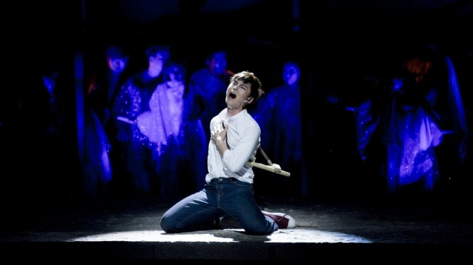
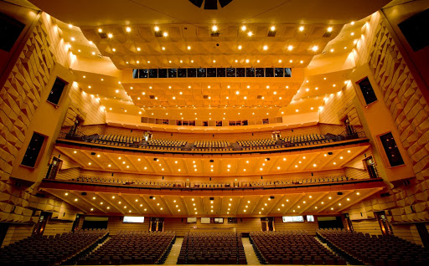
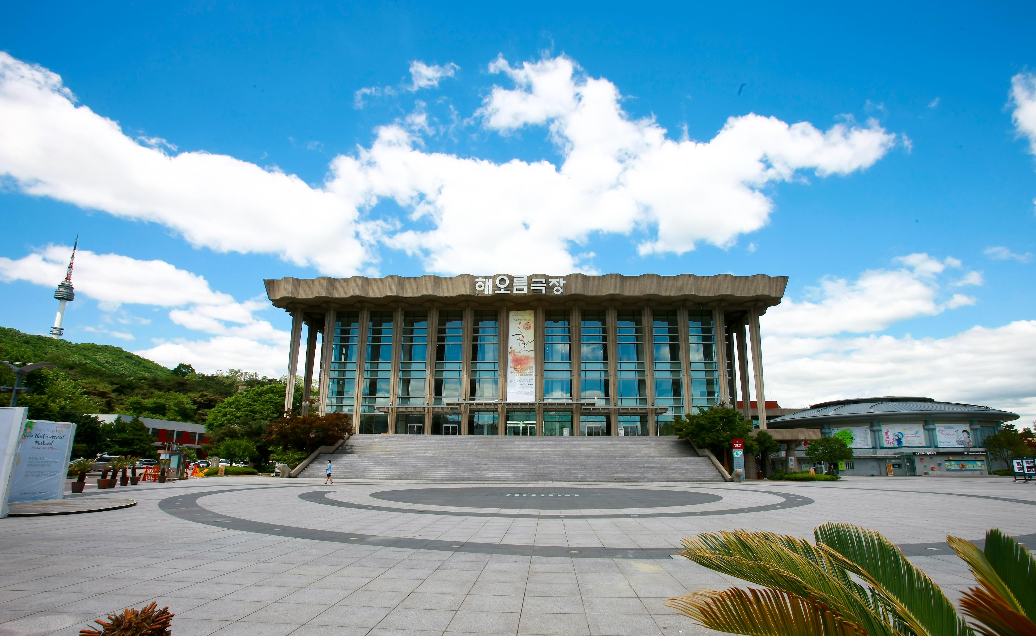
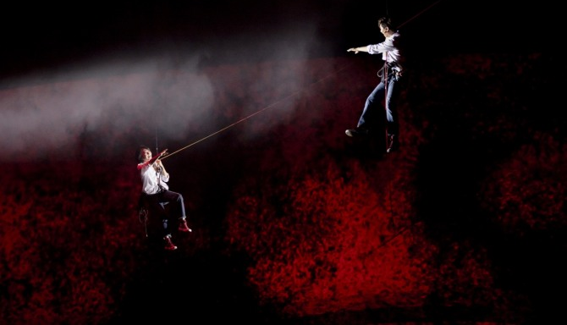
국립극장

Slide 13
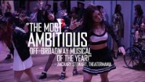

Slide 14
SEOUL-Y KOREAN & SOLELY AMERICAN
South Korea
Development starts in Seoul
United States
Development may start regionally
Typical run: 2-3 months
Irregular runs
Commercial industry is relatively new (50s); theatregoers are younger
Commercial industry is pioneered here (1920s); theatregoers are older
Agencies, Guilds, Unions
Agencies
“You’re just thrown out in the wilderness. You have to find your own way to survive here.”
“We like to derive and do crazy stuff… We’re finding out own voice and our own style.”
“The way they make musicals in the West is a little more... simple and rigid… by the book.”

Slide 15
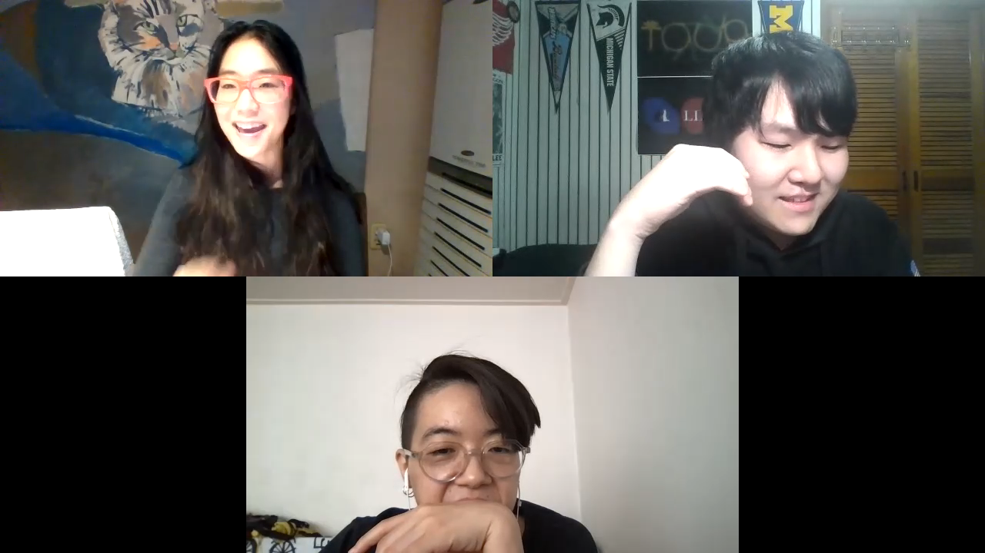

Slide 16
감사합니다
THANK YOU

